Slide 1
Information Technology UNIT-1

Slide 2
Introduction & Basic Concepts of Modern Communication & Technology

Slide 3
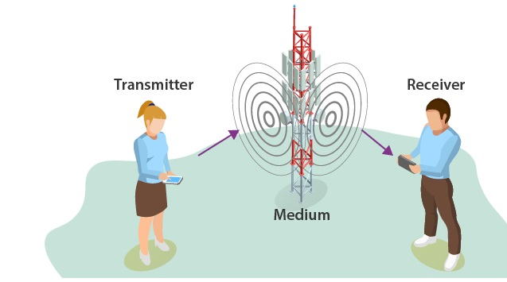
Communication Systems
The communication system is a system which describes the information exchange between two points.
The process of transmission and reception of information is called communication.
The major elements of communication are the Transmitter of information, Channel or medium of communication and the Receiver of information.

Slide 4
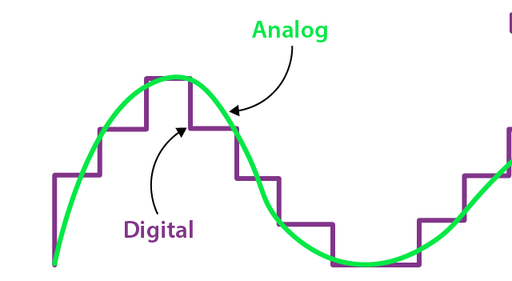
Types of Communication Systems
Analog communication :Communicates data as electronic signals of varying frequency or amplitude. Eg Broadcast and telephone transmission
Digial Communication :The data are generated and processed in two states: High (represented as 1) and Low (represented as 0). Digital technology stores and transmits data in the form of 1s and 0s.

Slide 5
Depending on the communication channel, the communication system is categorized as follows:
1. Wired (Line communication)
Parallel wire communication
Twisted wire communication
Coaxial cable communication
Optical fibre communication
2. Wireless (Space communication)
Ground wave communication
Skywave communication
Space wave communication
Satellite communication

Slide 6
Examples Of Communication Systems
The following are a few examples of communication systems:
Internet
2. Public Switched Telephone network
3. Intranet and Extranet
4. Television

Slide 7
Elements Of Communication Systems
Information
Message or information is the entity that is to be transmitted. It can be in the form of audio, video, temperature, picture, pressure, etc.
Signal
The single-valued function of time that carries the information. The information is converted into an electrical form for transmission.
Transducer
A device or an arrangement that converts one form of energy to the other. An electrical transducer converts physical variables such as pressure, force, temperature into corresponding electrical signal variations.
Example:
Microphone – converts audio signals into electrical signals. Photodetector – converts light signals into electrical signals.

Slide 8
Elements Of Communication Systems
Amplifier
The electronic circuit or device that increases the amplitude or the strength of the transmitted signal is called an amplifier. When the signal strength becomes less than the required value, amplification can be done anywhere in between transmitter and receiver.
Modulator
As the original message signal cannot be transmitted over a large distance because of their low frequency and amplitude, they are superimposed with high frequency and amplitude wave called carrier wave. This phenomenon of superimposing of message signal with a carrier wave is called modulation. And the resultant wave is a modulated wave which is to be transmitted.

Slide 9
Elements Of Communication Systems
Transmitter
It is the arrangement that processes the message signal into a suitable form for transmission and subsequently reception.
Antenna
An Antenna is a structure or a device that will radiate and receive electromagnetic waves. So, they are used in both transmitters and receivers. An antenna is basically a metallic object, often a collection of wires. The electromagnetic waves are polarised according to the position of the antenna.
Channel
A channel refers to a physical medium such as wire, cables, space through which the signal is passed from the transmitter to the receiver.

Slide 10
Channel impairments
Channel impairments that affect channel performance
Noise
Noise is one of the channel imperfection or impairment in the received signal at the destination.
External sources interference from nearby transmitted signals (cross talk),
interference generated by a natural source such as lightning,
solar or cosmic radiation, automobile generated radiation, etc. The external noise can be minimised and eliminated by the appropriate design of the channel, shielding of cables. anddigital transmission
Internal sources include noise due to random motion and collision of electrons in the conductors, thermal noise due to diffusion and recombination of charge carriers in other electronic devices. Internal noise can be minimized by cooling and using digital technology for transmission.
Distortion
It is also another type of channel problem. When the signal is distorted, the distorted signal may have frequency and bandwidth different from the transmitted signal. The variation in the signal frequency can be linear or non-linear.

Slide 11
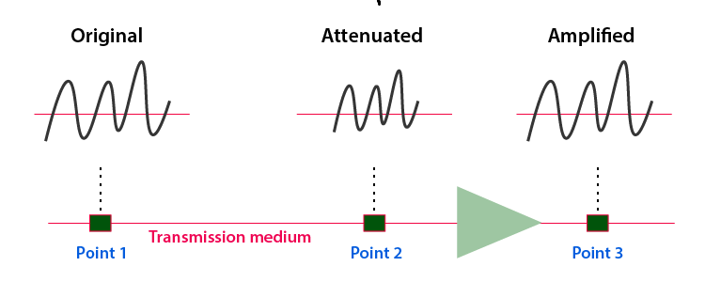
Channel impairments
Attenuation
Attenuation is a problem caused by the medium. When the signal is propagating for a longer distance through a medium, depending on the length of the medium the initial power decreases. The loss in initial power is directly proportional to the length of the medium. Using amplifiers, the signal power is strengthened or amplified so as to reduce attenuation.
Digital signals are comparatively less prone to attenuation than analogue signals.

Slide 12
Elements Of Communication Systems
Receiver
An arrangement that extracts the message or information from the transmitted signal at the output end of the channel and reproduces it in a suitable form as the original message signal is a receiver.
Demodulator
It is the inverse phenomenon of modulation. The process of separation of message signal from the carrier wave takes place in the demodulator. The information is retrieved from the modulated wave.

Slide 13
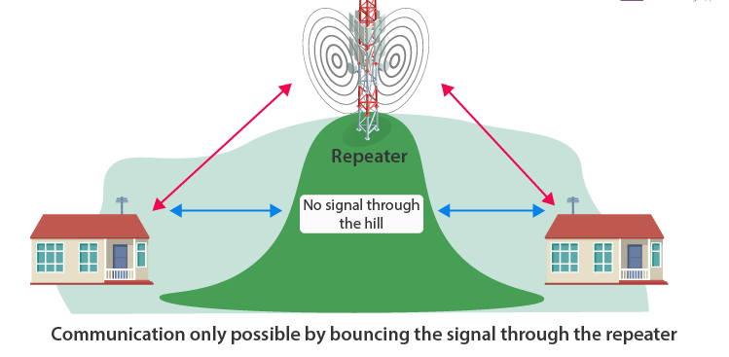
Elements Of Communication Systems
Repeaters
Repeaters are placed at different locations in between the transmitter and receiver. A repeater receives the transmitted signal, amplifies it and send it to the next repeater without distorting the original signal.

Slide 14
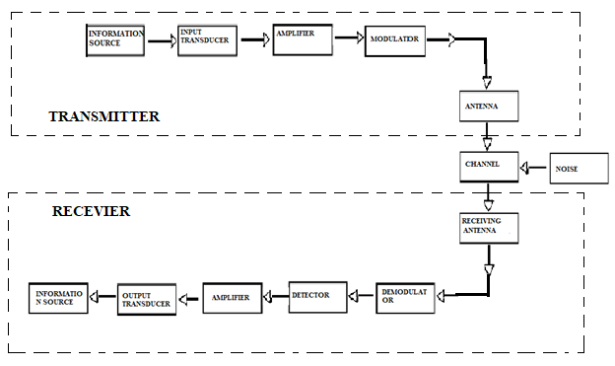
Block Diagram of Communication Systems
The block diagram given below represents the flow of the signal from the source to the destination. The role of every device and arrangement discussed above is better understood.

Slide 15
Elements Of Communication Systems
Different types of Modulation.
i. Amplitude Modulation (AM)
The process of changing the amplitude of the signal wave by impressing or superimposing it on a high-frequency carrier wave, keeping its frequency constant is called amplitude modulation.
ii. Frequency Modulation (FM)
Frequency modulation is a technique in which the frequency of the message signal is varied by modulating with a carrier wave. It is better than amplitude modulation because it eliminates noise from various sources.
iii. Phase Modulation (PM)
The phase of the carrier wave changes the phase of the signal wave. The phase shift after modulation is dependent on the frequency of the carrier wave as well. Phase modulated waves are immune to noise to a greater extent.

Slide 16
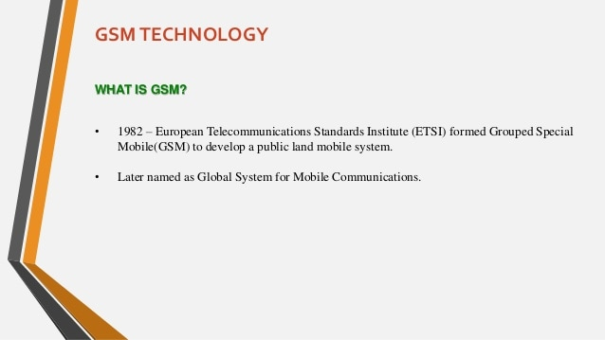

Slide 17
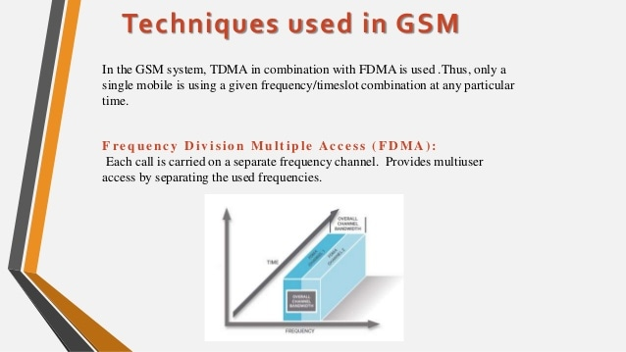

Slide 18
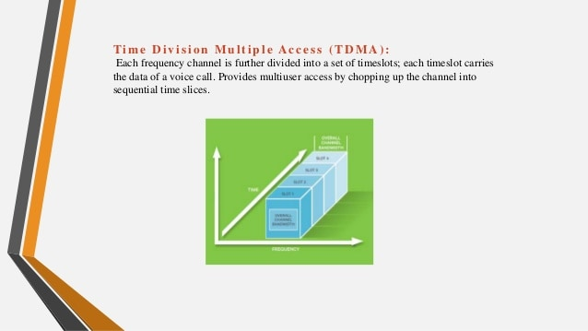

Slide 19
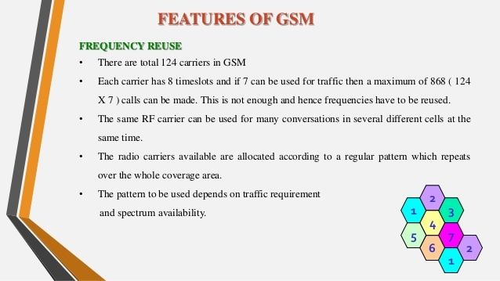

Slide 20
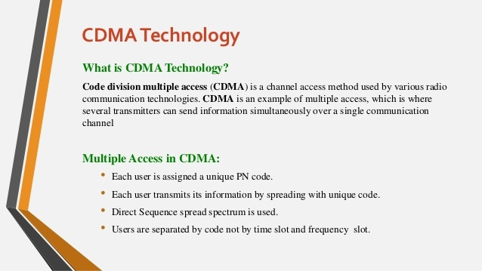

Slide 21
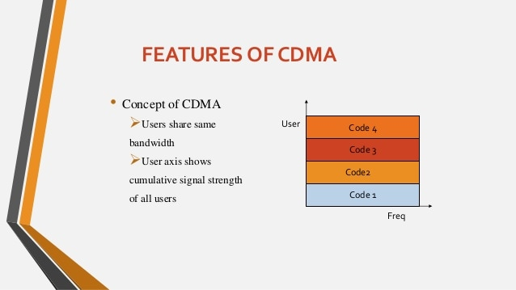

Slide 22
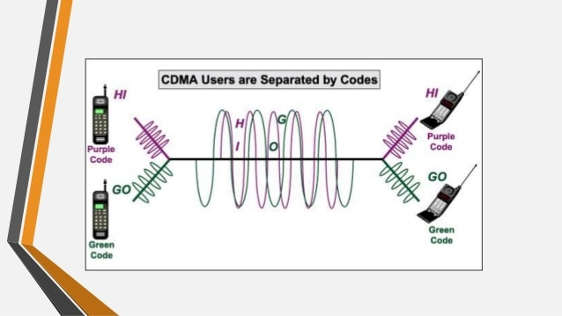

Slide 23
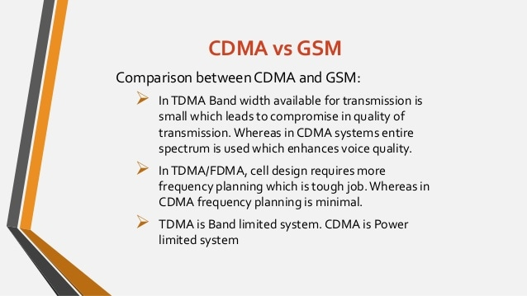

Slide 24
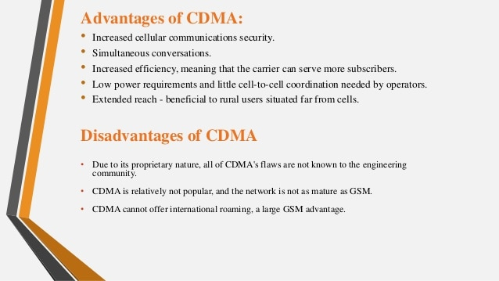

Slide 25
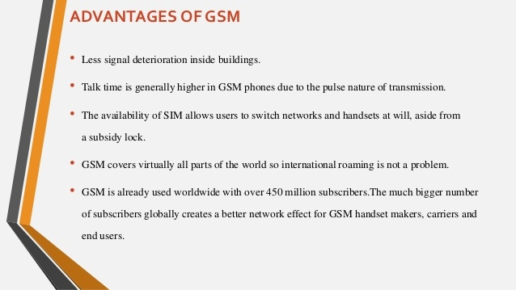

Slide 26
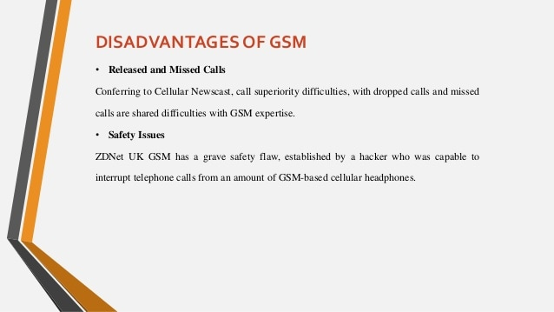

Slide 27
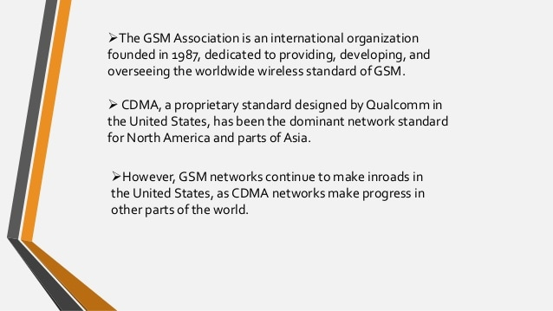

Slide 28
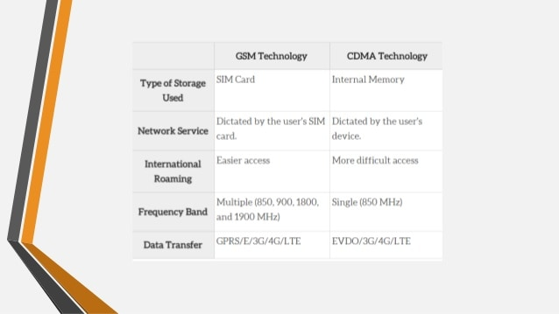

Slide 29
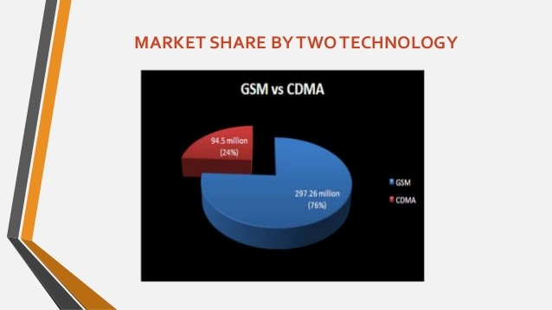

Slide 30
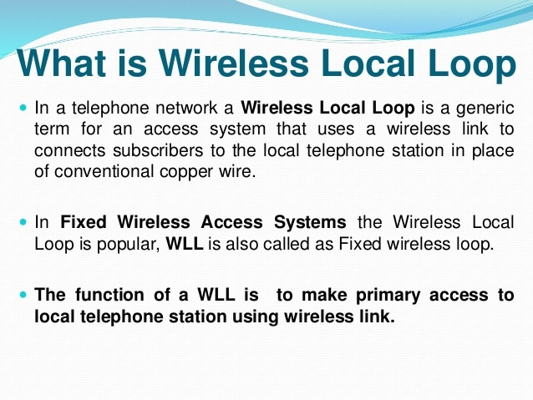

Slide 31
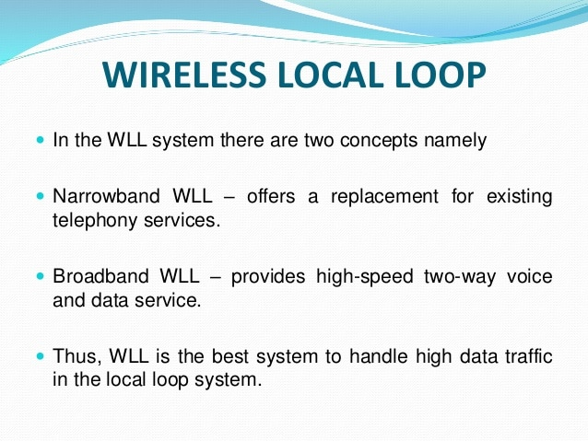

Slide 32
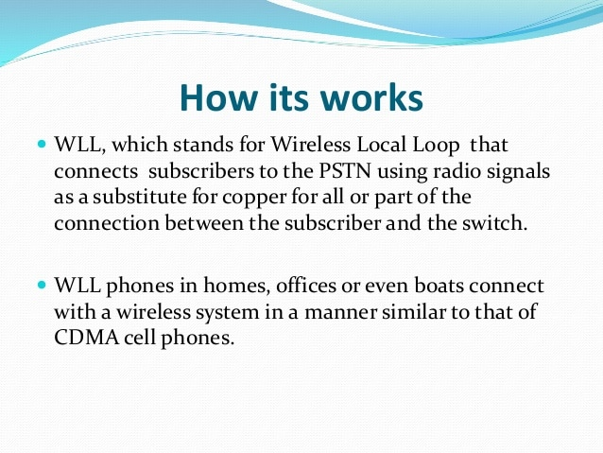

Slide 33
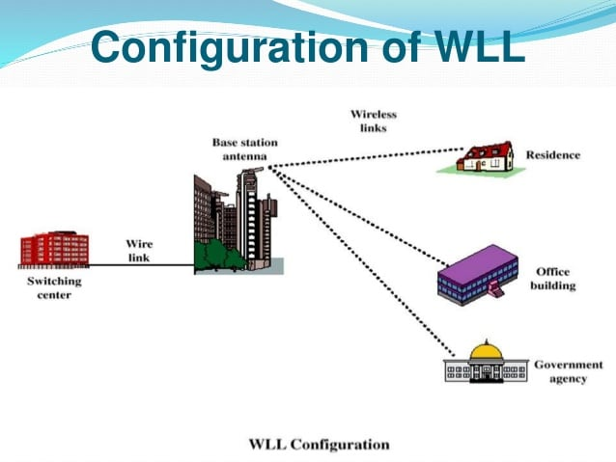

Slide 34
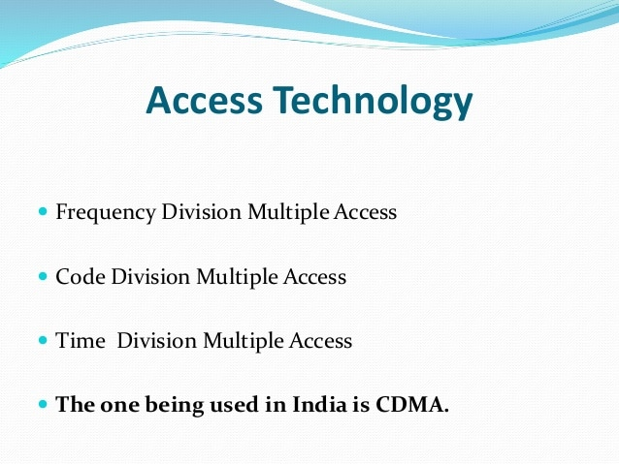

Slide 35
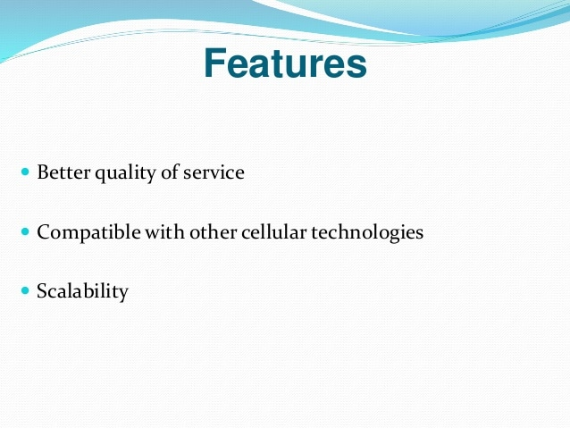

Slide 36
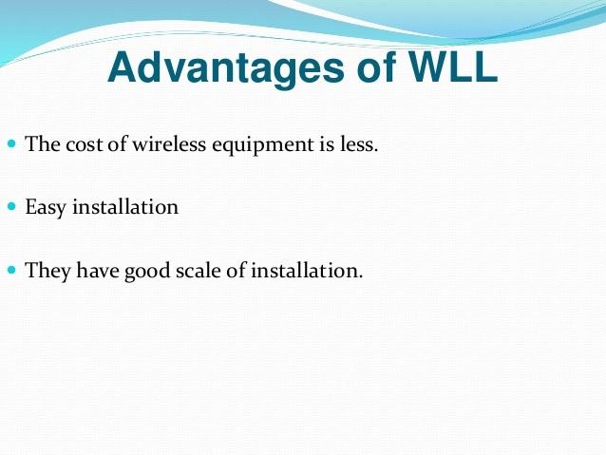

Slide 37
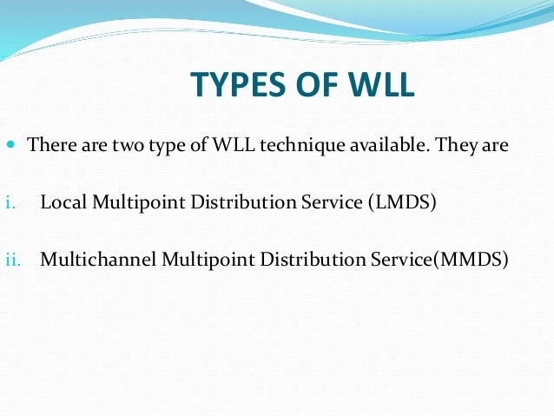

Slide 38
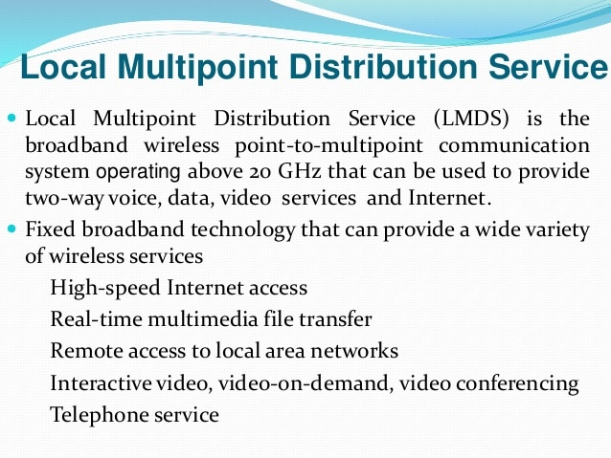

Slide 39
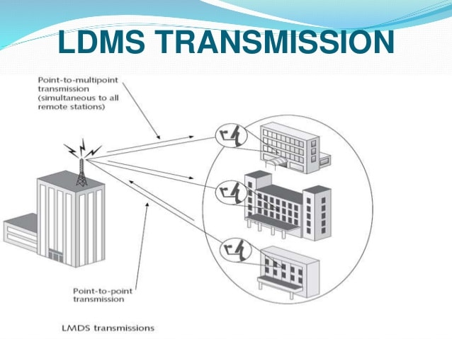

Slide 40
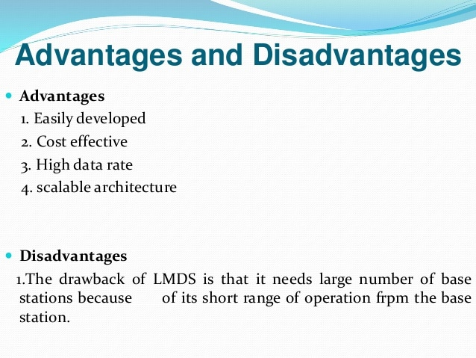

Slide 41
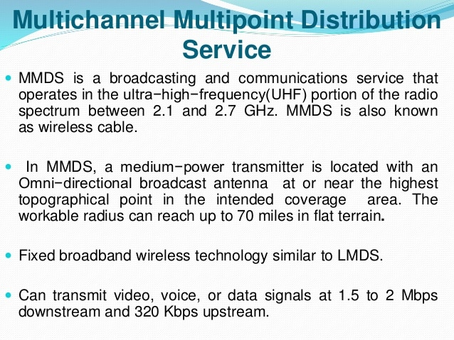

Slide 42
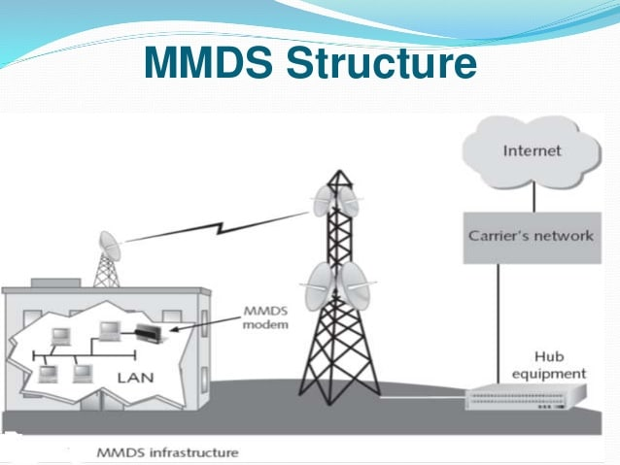

Slide 43
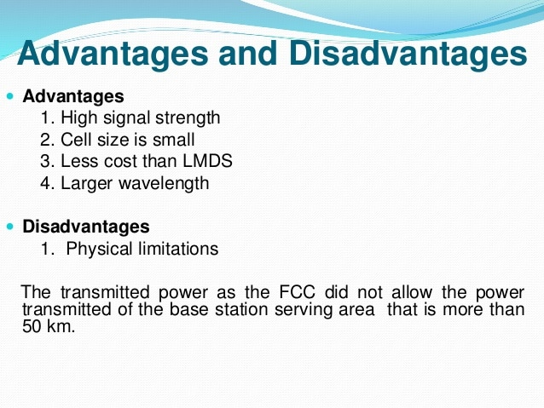

Slide 44
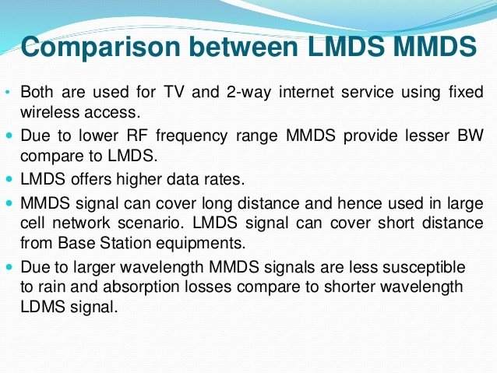

Slide 45
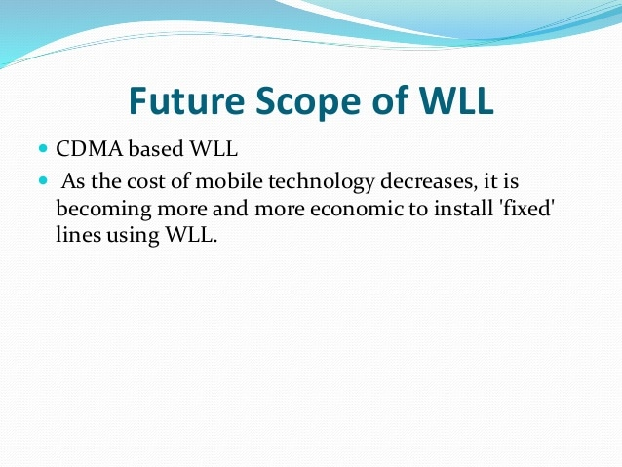

Slide 46
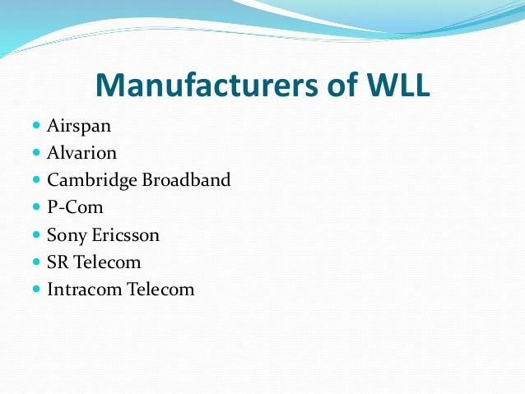

Slide 47
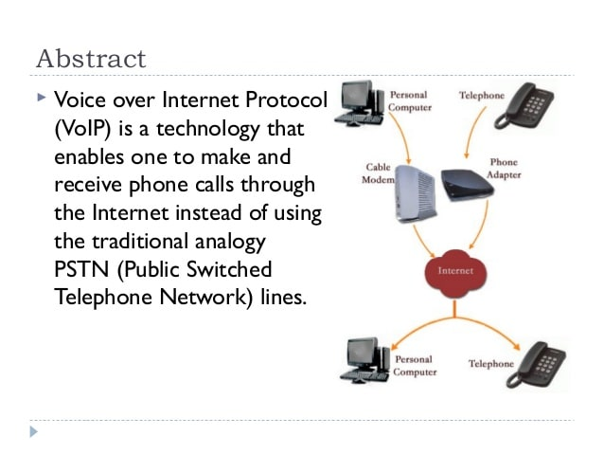
VOIP

Slide 48
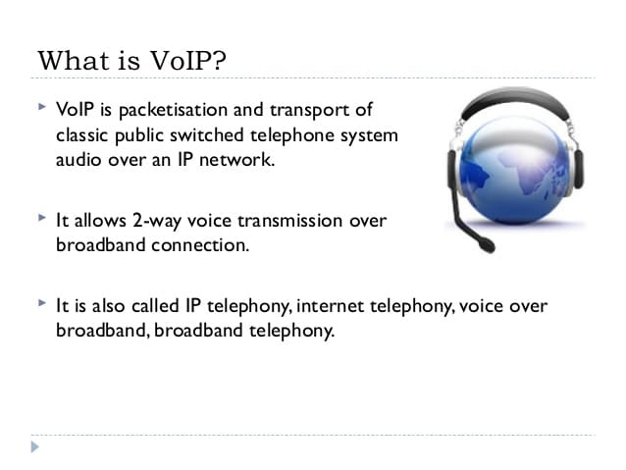

Slide 49
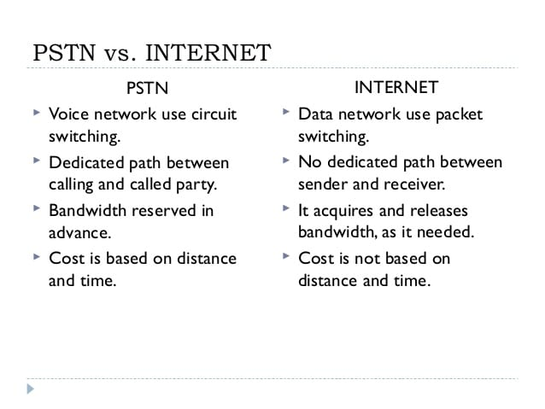

Slide 50
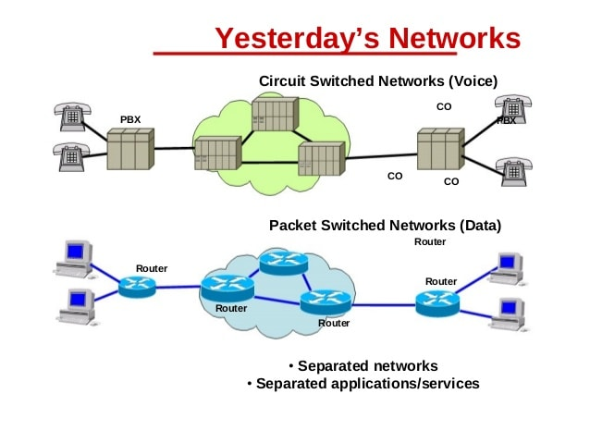

Slide 51
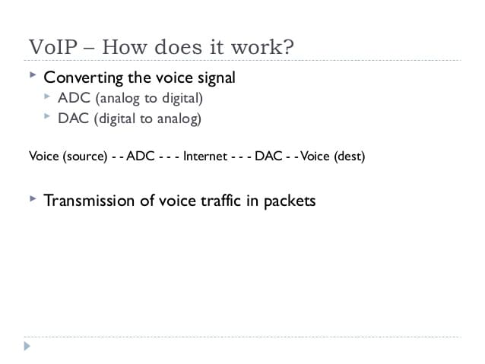

Slide 52
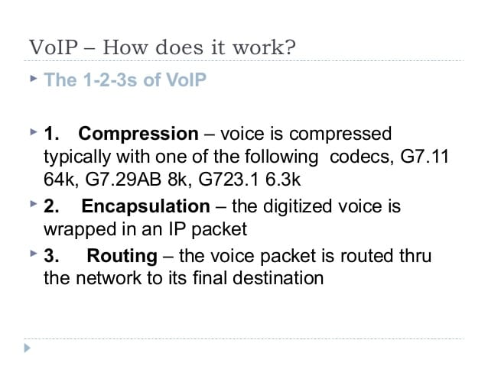

Slide 53
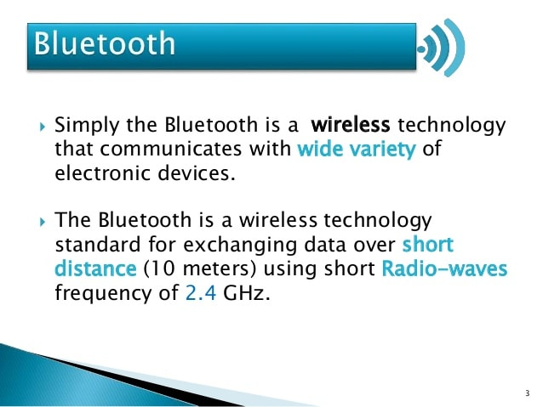
BLUETOOTH

Slide 54
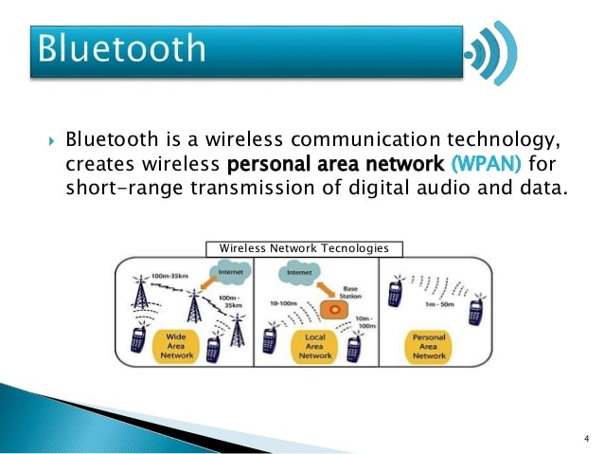

Slide 55
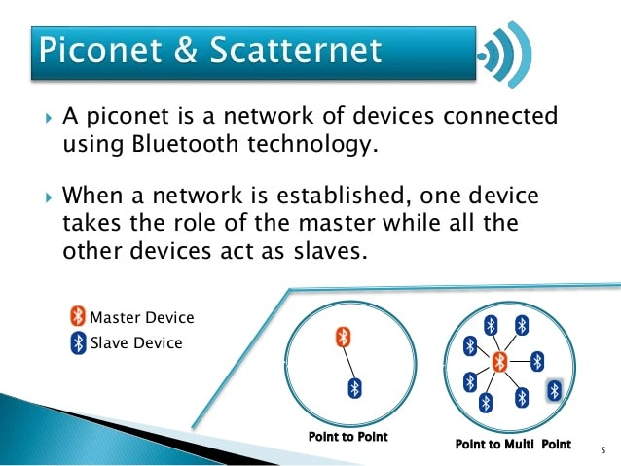

Slide 56
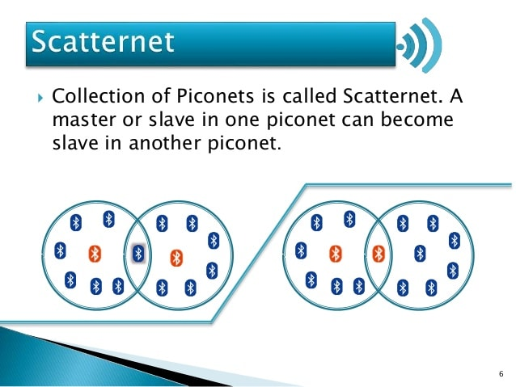

Slide 57
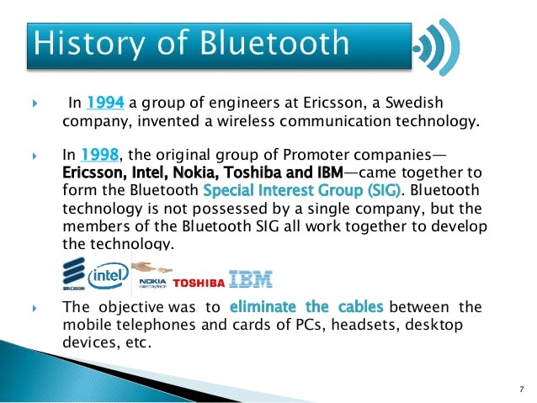

Slide 58
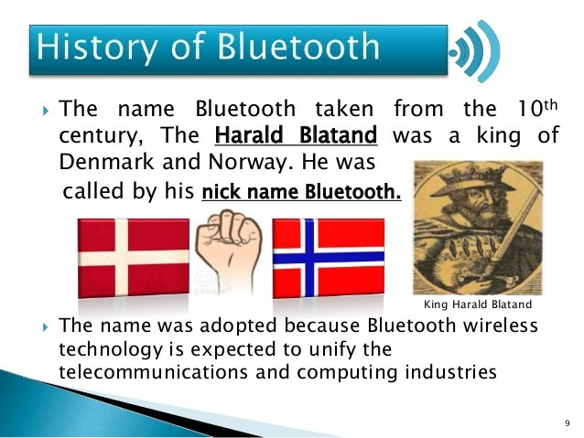

Slide 59
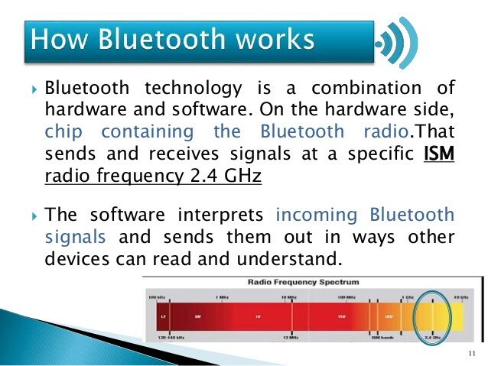

Slide 60
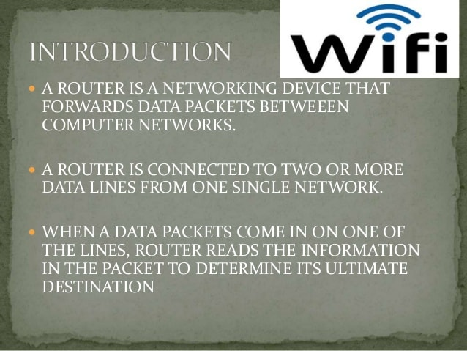
Wi-Fi

Slide 61


Slide 62


Slide 63


Slide 64


Slide 65


Slide 66


Slide 67


Slide 68

Communication Technology

Slide 69


Slide 70


Slide 71


Slide 72


Slide 73


Slide 74


Slide 75


Slide 76


Slide 77


Slide 78


Slide 79


Slide 80


Slide 81


Slide 82


Slide 83


Slide 84


Slide 85


Slide 86


Slide 87

Communication over radio

Slide 88


Slide 89


Slide 90


Slide 91


Slide 92


Slide 93


Slide 94


Slide 95


Slide 96


Slide 97


Slide 98


Slide 99


Slide 100


Slide 101


Slide 102


Slide 103


Slide 104


Slide 105


Slide 106


Slide 107

Communication Satellite

Slide 108


Slide 109


Slide 110


Slide 111


Slide 112


Slide 113


Slide 114


Slide 115


Slide 116


Slide 117


Slide 118


Slide 119


Slide 120


Slide 121


Slide 122


Slide 123


Slide 124


Slide 125


Slide 126


Slide 127


Slide 128


Slide 129


Slide 130


Slide 131


Slide 132


Slide 133


Slide 134


Slide 135


Slide 136


Slide 137


Slide 138


Slide 139


Slide 140


Slide 141


Slide 142


Slide 143


Slide 144


Slide 145


Slide 146


Slide 147


Slide 148


Slide 149


Slide 150


Slide 151


Slide 152


Slide 153


Slide 154


